Slide 1
Heart Failure Prediction Using Machine Learning
AIE504 – Machine Learning Proposal
Presented by: Chahyaandida Ishaya
Department: Computer Engineering
Supervisor: Assoc. Prof. Dr. Evrim Guler
Date: __/__/__

Slide 2
Background / Introduction
• Heart failure is a major global public health issue.
• Early prediction can significantly reduce mortality.
• Machine learning provides automated, accurate risk-prediction models.
• This study uses clinical dataset variables to build predictive models.

Slide 3
Problem Statement
• Heart failure causes over 26 million cases worldwide.
Traditional clinical assessment is often subjective.
• Need a data-driven, reliable, early-warning prediction system.
• How can machine learning improve predictive accuracy?

Slide 4
Aim of the Study
To develop and evaluate machine learning models capable of predicting heart failure risk using patient clinical attributes.

Slide 5
Objectives
• Load and preprocess heart failure dataset.
• Perform exploratory data analysis (EDA).
• Train and compare machine learning models:
– Logistic Regression
– Random Forest
– Support Vector Machine (SVM)
– XGBoost / Gradient Boosting
• Identify key predictive features.
• Evaluate model performance using standard metrics.

Slide 6
Dataset Description
Source: Kaggle
Key Variables:
The dataset contains 11 clinical predictors—Age (years), Sex (M/F), ChestPainType (TA/ATA/NAP/ASY), RestingBP (mm Hg), Cholesterol (mg/dl), FastingBS (0/1), RestingECG (Normal/ST/LVH), MaxHR (bpm), ExerciseAngina (Y/N), Oldpeak (ST depression value), and ST_Slope (Up/Flat/Down)—used to classify the presence or absence of heart disease.

Slide 7
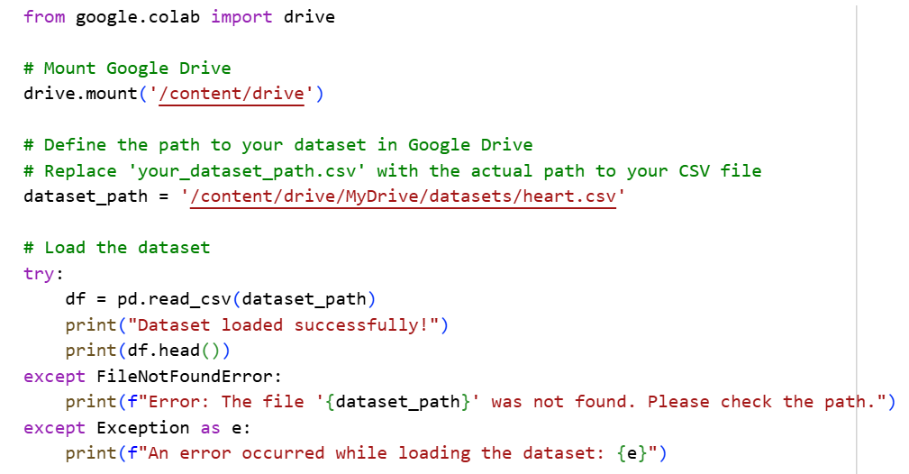
DataSet Loading

Slide 8
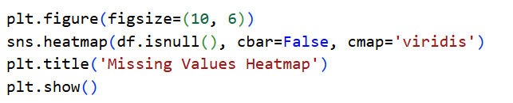
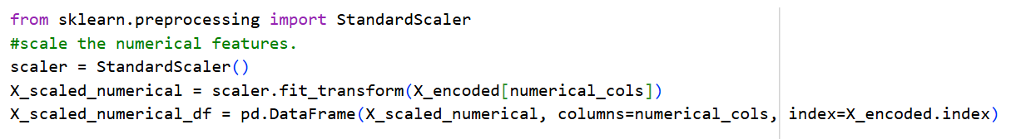
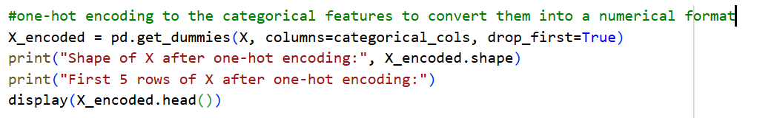
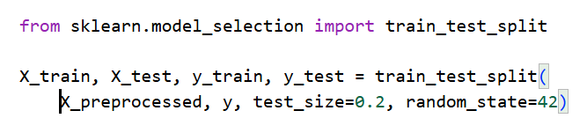
Methodology Overview
Data Preprocessing:
• Handling missing values
• Feature scaling
• Encoding categorical variables
Model Training:
• Split into training/testing sets
• Cross-validation
Evaluation:
• Accuracy
• Precision, Recall, F1-Score
• ROC-AUC Curve

Slide 9
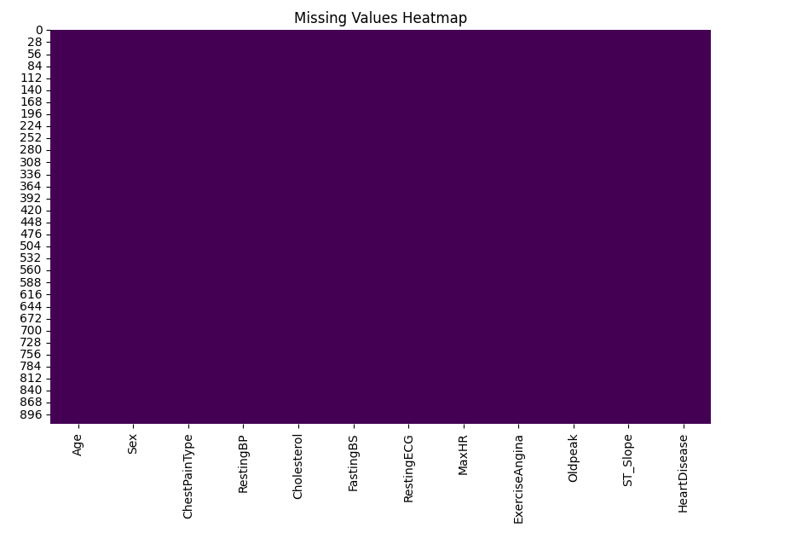

Slide 10
Exploratory Data Analysis (EDA)
• Statistical summaries
• Distribution of variables
• Correlation heatmap
• Visual relationships between features and outcome

Slide 11
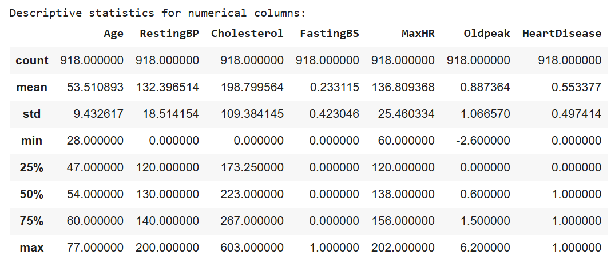
Exploratory Data Analysis (EDA)…

Slide 12
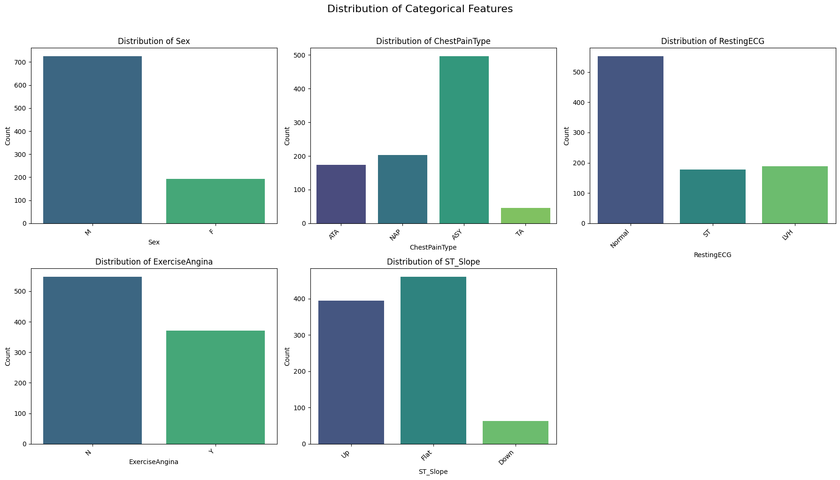
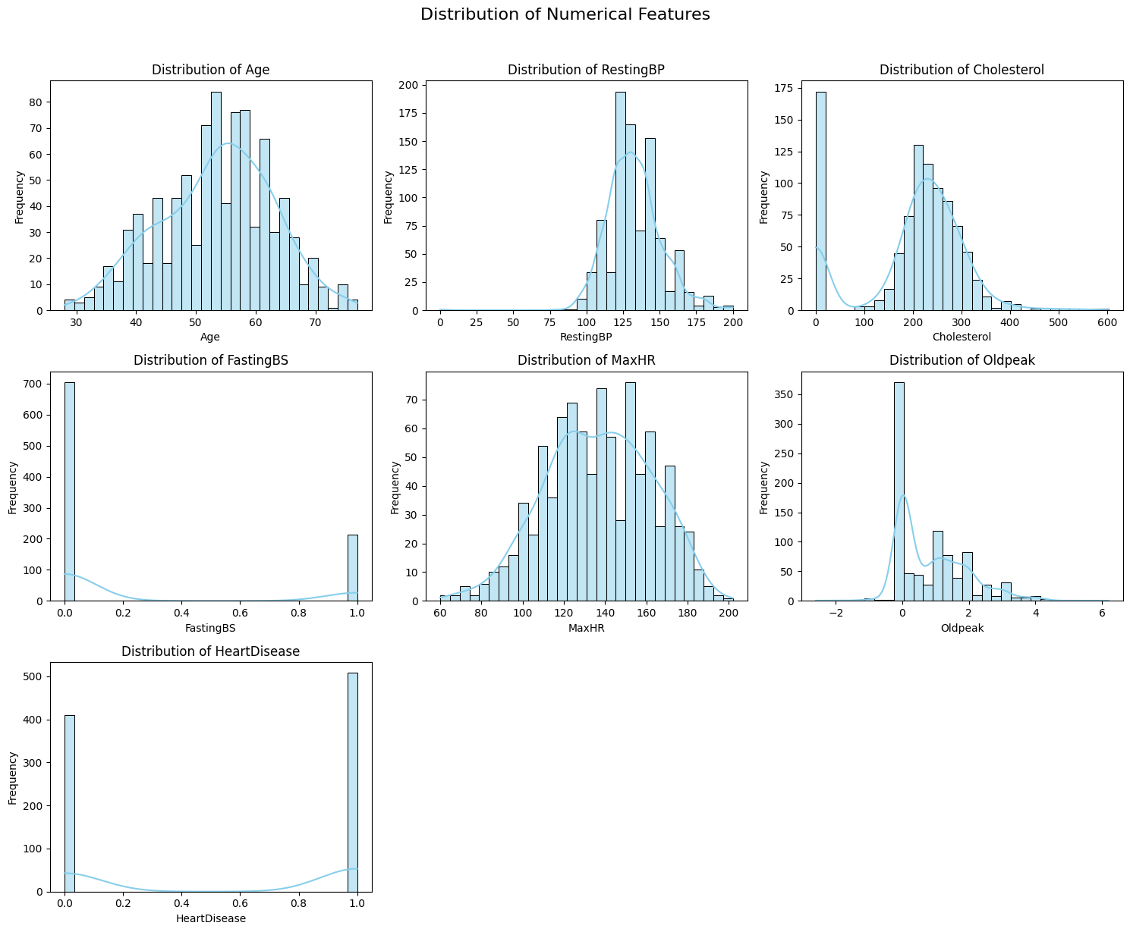
Exploratory Data Analysis (EDA)…

Slide 13
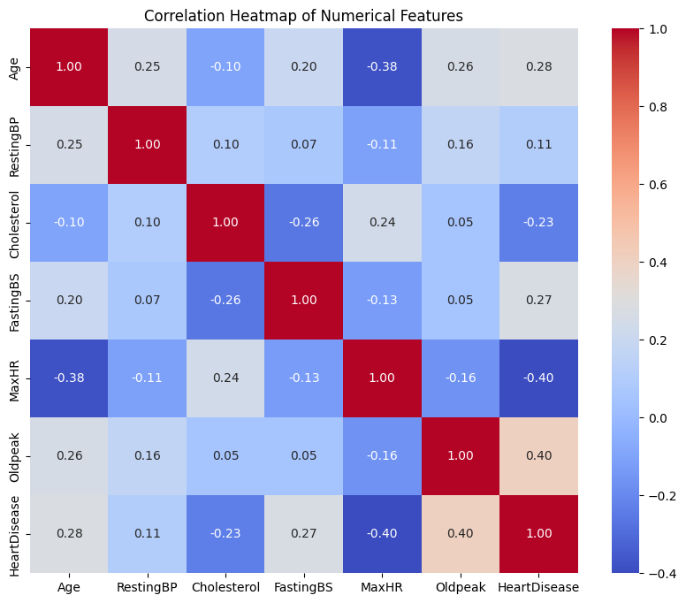
Exploratory Data Analysis (EDA)…

Slide 14
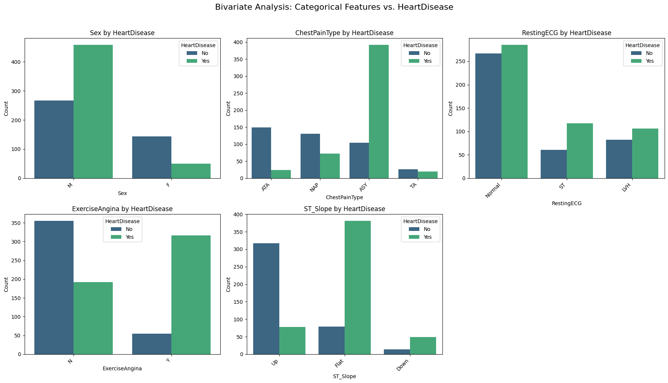
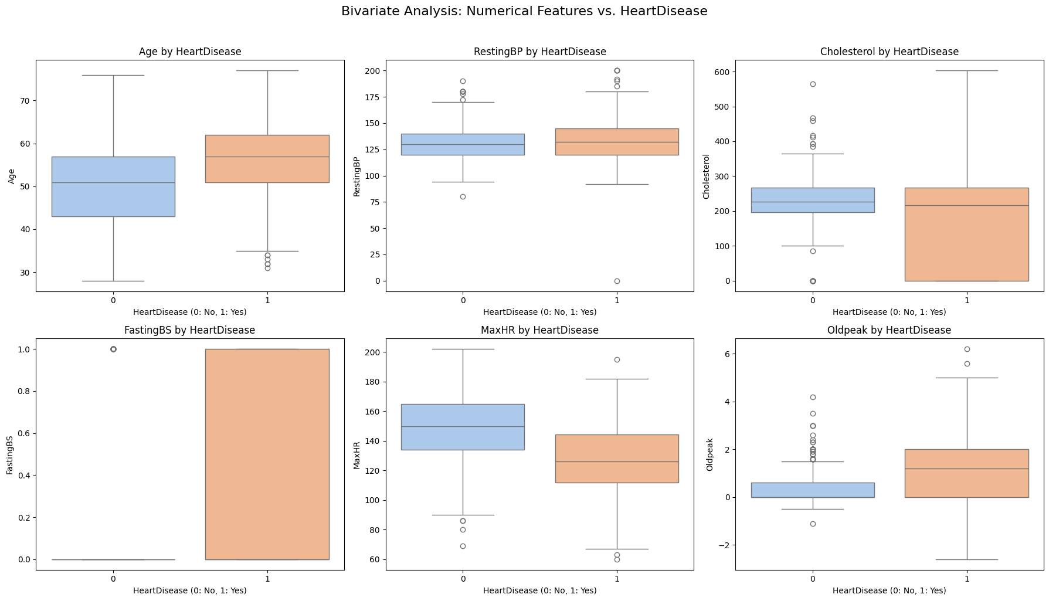
Exploratory Data Analysis (EDA)…

Slide 15
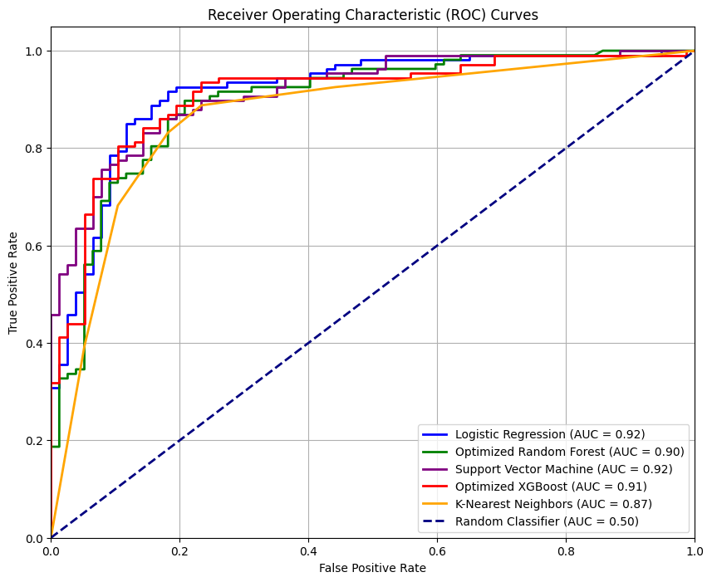
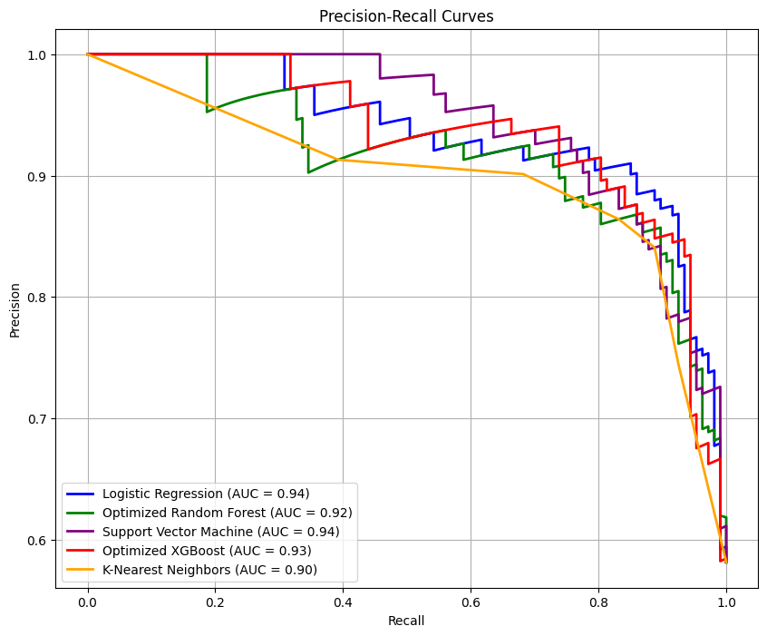
Machine Learning Models

Slide 16
Evaluation Metrics
• Accuracy – Overall correctness
• Precision & Recall – Class imbalance handling
• Confusion Matrix – Performance visualization
• ROC-AUC – Discrimination ability

Slide 17
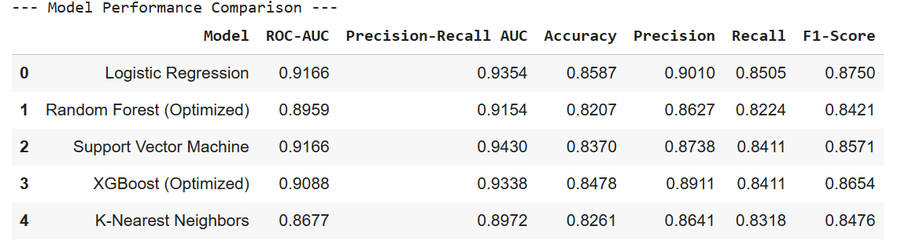
Evaluation Metrics…

Slide 18
Expected Results
• Improved predictive accuracy using ensemble models
• Identification of critical risk variables
• Model with highest ROC-AUC selected as final

Slide 19
Project Significance
• Supports early diagnostic decision-making
• Helps clinicians identify high-risk patients
• Contributes to medical AI research in cardiovascular health

Slide 20
Conclusion
• Machine learning can significantly enhance prediction of heart failure.
• The project aims to build a robust predictive model for early detection.
• Future extensions may include deployment as a mobile or web app.

Slide 21
References
• Kaggle, UCI Machine Learning Repository

